Slide 1
Linear Algebra
Lecture 41

Slide 2
Linear Algebra
Lecture 41

Slide 3
Segment VI
Orthogonality and
Least Squares

Slide 4
Gram-Schmidt
Process

Slide 5
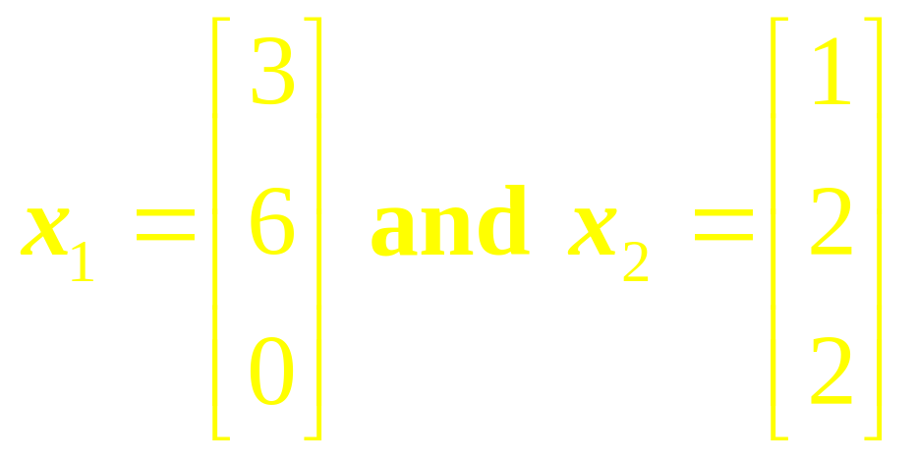
Example 1
Let W = Span {x₁, x₂}, where
Construct an orthogonal basis {v₁, v₂} for W.

Slide 6
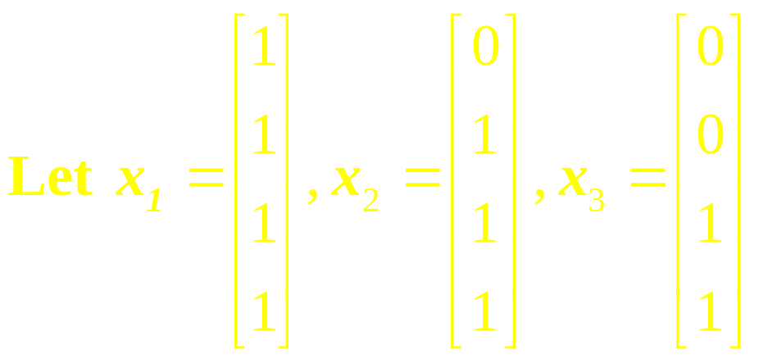
Example 2
Then {x₁, x₂, x₃} is linearly independent and thus, a basis for a subspace W of R⁴. Construct an orthogonal basis for W.

Slide 7
Theorem
Given a basis {x₁, …, x_{p}} for a subspace W of R^{n} , define
…

Slide 8
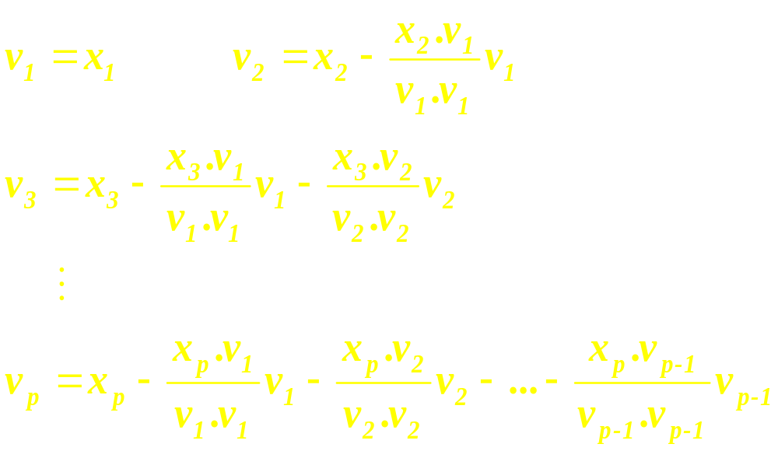
Continued
…

Slide 9
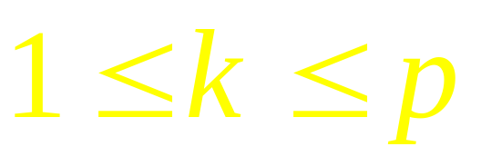
Continued
Then {v₁, …,v_{p}} is an orthogonal basis for W.
In addition
Span {v₁, …, v_{k}}= Span {x₁,…, x_{k}} for

Slide 10
Orthonormal
Bases

Slide 11
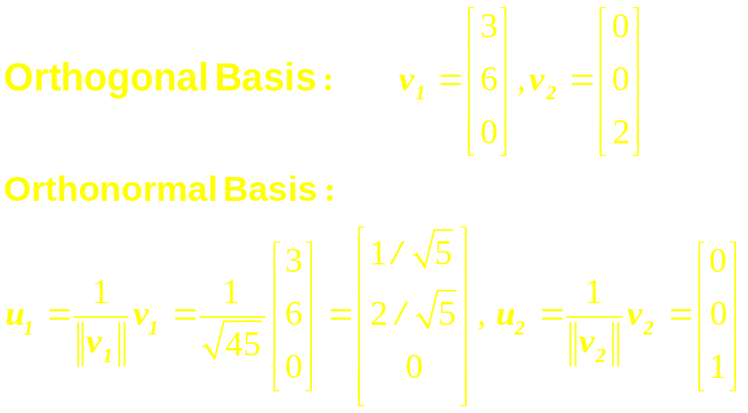
Example 3

Slide 12
Theorem
If A is an m x n matrix with linearly independent columns, then A can be factored as A = QR
…

Slide 13
Continued
Where Q is an m x n matrix whose columns form an orthonormal basis for Col A and R is an n x n upper triangular invertible matrix with positive entries on its diagonal.

Slide 14
Proof of the
Theorem

Slide 15
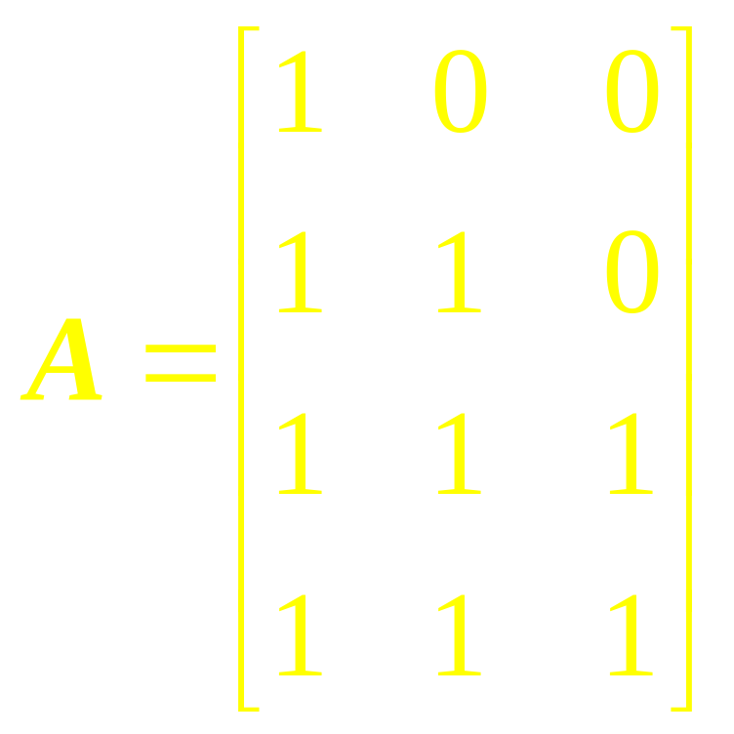
Example 4
Find a QR factorization of

Slide 16
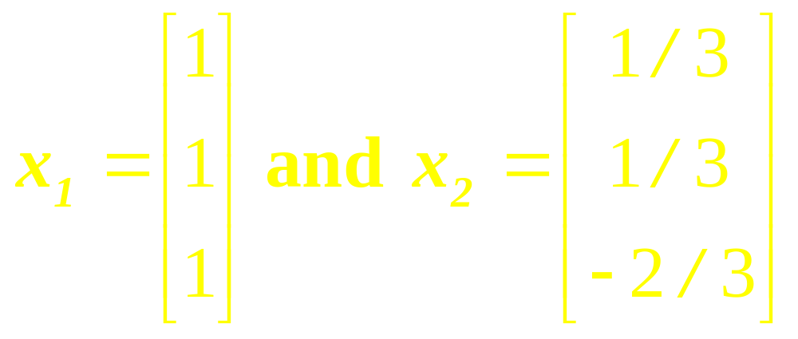
Example 5
Let W = Span {x₁, x₂}, where
Construct an orthonormal basis for W.

Slide 17
Theorem
Given a basis {x₁, …, x_{p}} for a subspace W of R^{n} , define
…

Slide 18
Continued
…

Slide 19
Continued
Then {v₁, …,v_{p}} is an orthogonal basis for W.
In addition
Span {v₁, …, v_{k}}= Span {x₁,…, x_{k}} for

Slide 20
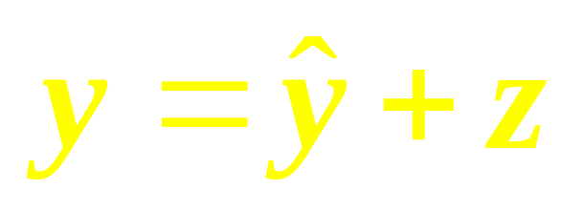

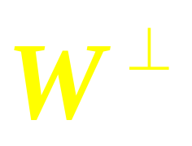
The Orthogonal
Decomposition Theorem
Let W be a subspace of R^{n}. Then each y in R^{n} can be written uniquely in the form
where is in W and z is in .
…

Slide 21
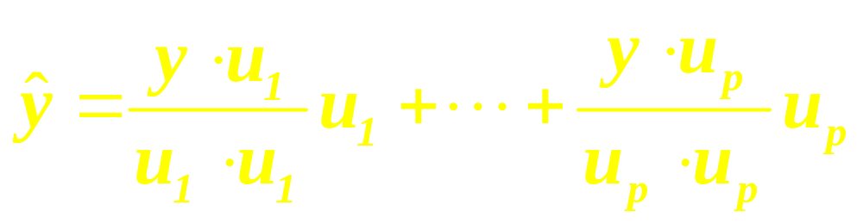

Continued
In fact, if {u₁, …, u_{p}} is any orthogonal basis of W, then
and z = y – . The vector is called the orthogonal projection of y onto W and often is written as proj_{w} y.

Slide 22
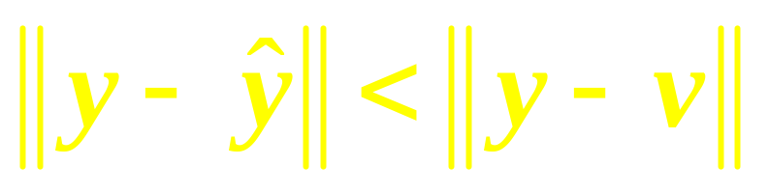
Best Approximation
Theorem
Let W be a subspace of R^{n}, y any vector in R^{n}, and the orthogonal projection of y onto W. Then is the closest point in W to y, in the sense that for all v in W distinct from .
…

Slide 23
Continued
The vector in this theorem is called the best approximation to y by elements of W.

Slide 24
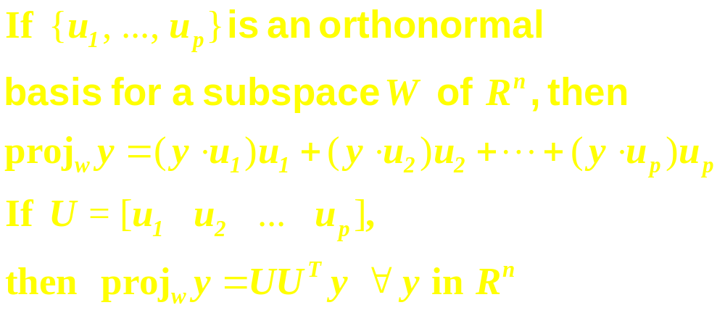
Theorem

Slide 25
Linear Algebra
Lecture 41

